Slide 1


Update on Recurrent pregnancy Loss (RPL)

Slide 2
Definition
A pregnancy loss is defined as the spontaneous demise of a pregnancy from the time of conception until 24 weeks of gestation (ACOG- before 20th week)
A diagnosis of Recurrent Pregnancy Loss (RPL) could be considered after the loss of two or more pregnancies.
Ref: Recurrent Pregnancy Loss – Guideline of the European Society of Human Reproduction and Embryology. Belgium: ESHRE, 2022.

Slide 3
Epidemiology
The incidence of pregnancy loss among clinically recognized pregnancies is 12–15%. However, unrecognized pregnancy loss is thought to be much greater.
There is the suggestion that 15% of fertilized ova are lost before implantation, with an overall conception loss rate of up to 52%.
Approximately 80% of all cases of pregnancy loss occur within the first trimester.
Maternal age and the number of previous miscarriages independently predict future miscarriage.
5% of couples will likely experience two or more losses,1% will experience three or more losses.
Ref- Recurrent pregnancy loss A summary of international evidence-based guidelines and practice, AJGP Vol. 47, No. 7, July 2018

Slide 4
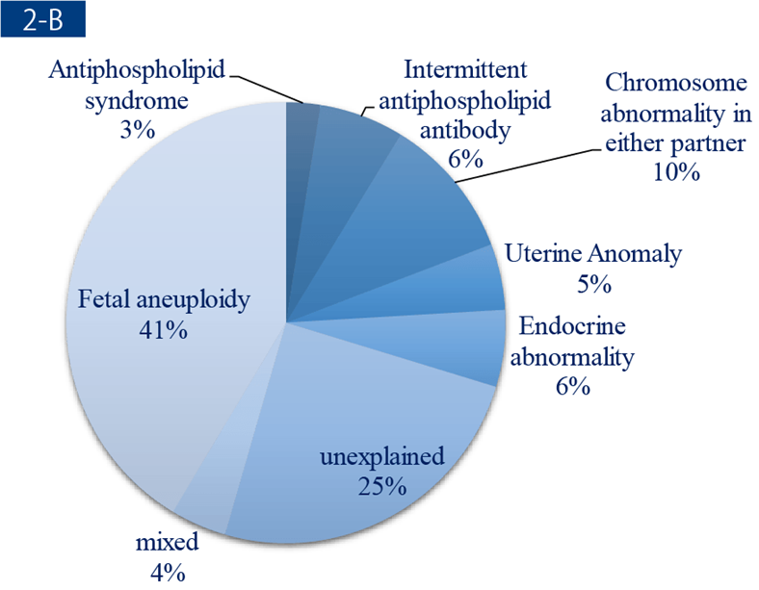
etiology of rPL
Approximately 50% of all cases of early pregnancy loss are due to fetal chromosomal abnormalities. Advanced female age is another well-established risk factor for female subfertility, fetal anomalies, stillbirth, and obstetric complications. The risk of pregnancy loss is lowest in women aged 20 to 35 years and rapidly increases after the age of 40.
Ref- Early Pregnancy Loss, ACOG practice bulletin, N 100, 2018

Slide 5
Other significant causes are -
Anatomical anomalies: Uterine leiomyoma, Müllerian anomalies, uterine synechiae, chronic endometritis.
Thrombophilia
Endocrinological causes: Thyroid disorders, impaired glucose metabolism, polycystic ovary syndrome (PCOS), progesterone deficiency, elevated prolactin.
Infection
Occupational or environmental exposure
Unhealthy lifestyle
Stress

Slide 6
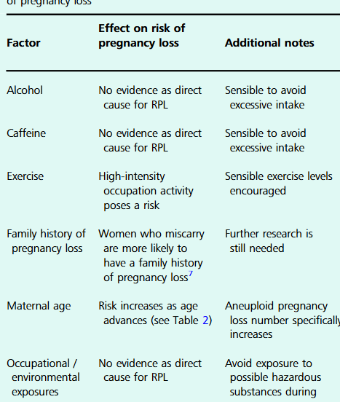
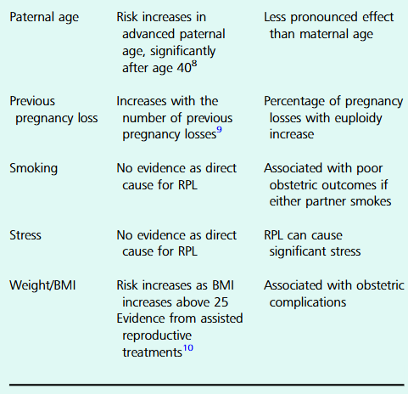
Risk factors of RPL

Slide 7
Management
The management of people with RPL is multifactorial and should include lifestyle modification, psychological support and specific treatment of any identified cause.
Ideally, patients should attend as a couple to the RPL clinic.
The first consultation should include a full medical, obstetric and family history with information on the lifestyle of both male and female partners, such as smoking, excessive alcohol consumption, excessive exercise, being overweight or underweight.
In addition to lifestyle factors, information should be collected on a previous diagnosis of medical conditions that may be associated with RPL, including thrombophilia, PCOS, and diabetes, or a family history of hereditary thrombophilia.

Slide 8
Investigation
Medical and family history should be used to tailor diagnostic investigations in RPL.
From the evidence and recommendations in ESHRE-2022 guideline, some diagnostic tests, although not recommended for all couples, can be relevant only in selected RPL couples. The list of recommendations on diagnostic workup is as follows-

Slide 9
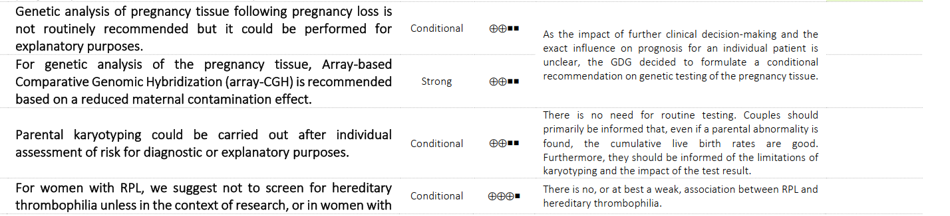
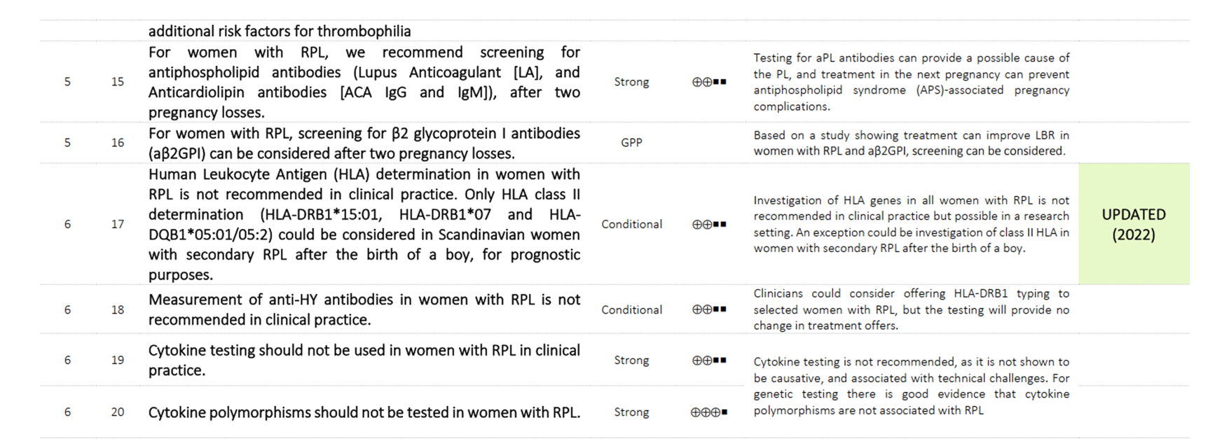
Investigations in RPL

Slide 10
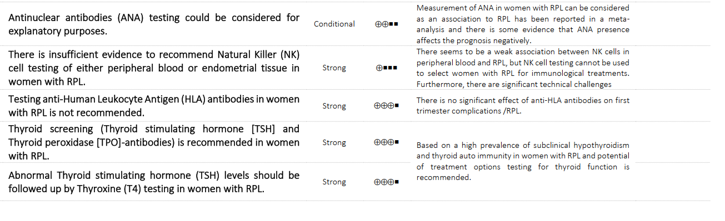

Slide 11
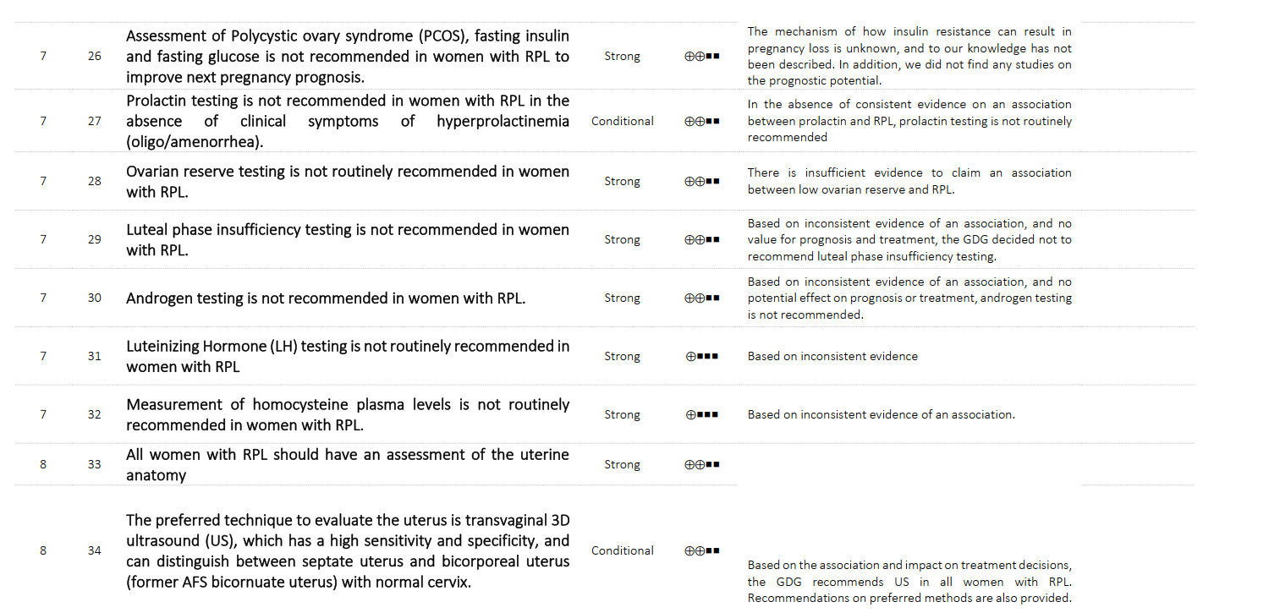
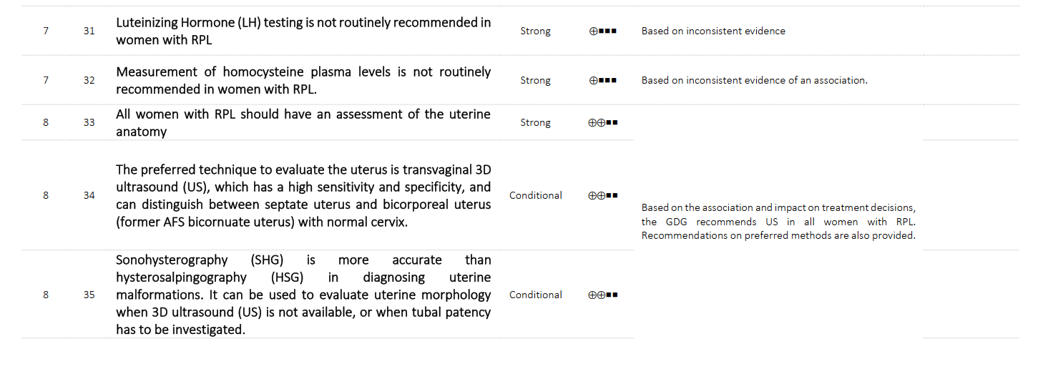

Slide 12
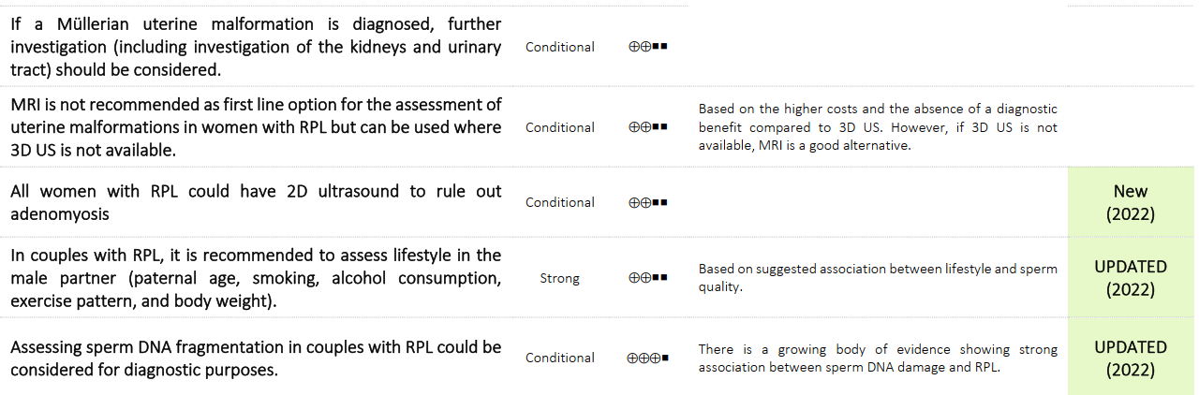

Slide 13

Treatments
While evidence-based treatments are limited for RPL, patients prefer to have a plan for the next pregnancy. Such plans are usually dependent on if any modifiable causes are found.
The guidelines recommend to base prognosis on woman’s age and her complete pregnancy history, including number of previous pregnancy losses, live births and their sequence.
Prognostic tools can be used to provide an estimate of subsequent chance of live birth in couples with RPL.

Slide 14
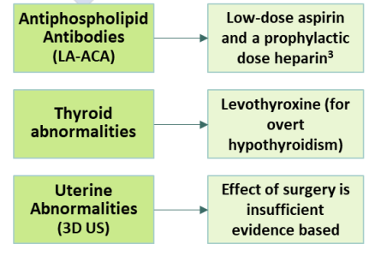
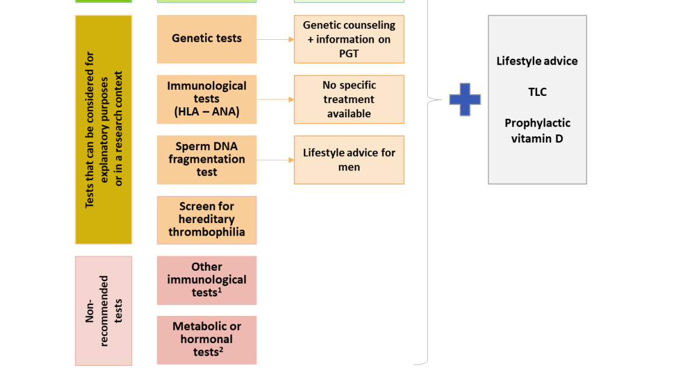
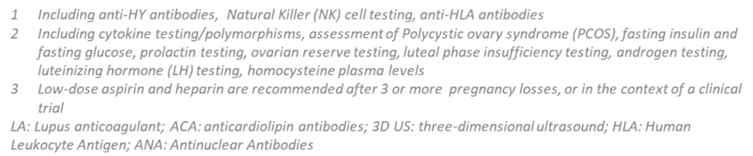
RPL ≥ 2PLS
Recommended tests
Tests that can be considered for explanatory purposes or in a research context
Non- recommended tests
Lifestyle advice, TLC, Prophylactic vitamin D
Ref - Recurrent Pregnancy Loss – Guideline of the European Society of Human Reproduction and Embryology. Belgium: ESHRE, 2022.

Slide 15

The changes of immune system during pregnancy
Clinical evidence in humans indicate that normal pregnancy is associated with enhanced humoral responses and somewhat depressed cell-mediated immunity.
This dampening of cell-mediated immunity and augmentation of humoral immunity during pregnancy is consistent with a dampening of Th1 reactivity and augmentation of Th2 immunity
Wegmann TG, Lin H, Guilbert L, Mosmann TR: Bidirectional
cytokine interactions in the maternal-fetal relationship: is successful
pregnancy a Th2 phenomenon? Immunol Today 1993; 14:353–356.

Slide 16
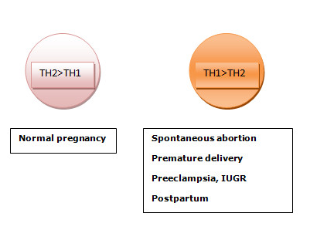
Pregnancy seems to prompt a shift toward Th2 bias.
While normal pregnancy is associated with a Th2/anti-inflammatory cytokine profile, unexplained recurrent spontaneous miscarriage (RSM) or recurrent pregnancy loss (RPL) appears to be associated with a Th1/pro-inflammatory cytokine profile.
Spontaneous miscarriage, defined as a clinically
detectable pregnancy loss prior to 20 weeks of
gestation, is one of the most common complications of pregnancy with approximately one in every four pregnant women

Slide 17
The role of progesterone in maintaining pregnancy
In early pregnancy, it is secreted from ovary by corpus luteum and helps in endometrial growth.
Progesterone modulates the immune response of mother to prevent rejection of embryo.
    It produces progesterone induced blocking factor (PIBF) which inhibit NK cell activity.
    It shifts the balance from unfavorable cytokines Th1 to favorable cytokinesTh2.
    Progesterone enhances uterine quiescence and suppress uterine contractions
    Progesterone may help in prevention of cervical dilatation also.

Slide 18
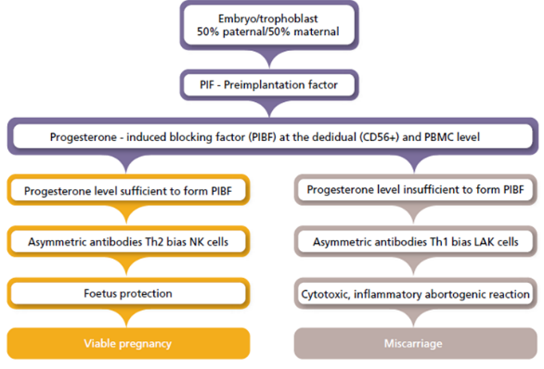
The role of progesterone in maintaining pregnancy

Slide 19
Choosing the right progestogen

Slide 20
Physiological Effects of Progesterone
Both the natural progesterone and synthetic progestins interact not only with the progesterone receptor (PR) but also with other steroid receptors. Therefore, depending on the derivative molecule (either progesterone or testosterone), these progestins may, exert androgenic, anti- androgenic, mineralocorticoid or glucocorticoid-like effects.
The extent to which the progestational effects are maximized and androgenic effects are minimized is referred to as progestational selectivity.
A selective progestin has progestational effects at relatively low concentrations or doses and androgenic effects at only relatively high concentrations or doses.

Slide 21
Molecules commonly used in practice
Natural Progesterone
Dydrogesterone
Allylestrenol
Hydroxyprogesterone Caproate

Slide 22
Natural Progesterone
Live birth rate was found significantly higher compared to vaginal progesterone according to Lotus trial.
Allylestrenol
Synthetic progestogen, used as an affordable means to maintain pregnancy.
Hydroxyprogesterone Caproate
Clinically practiced to prevent recurrent Preterm Birth and to prolong pregnancy.
Dydrogesterone
No significant difference in live birth rates compared to placebo
Large scale studies like PROMISE and OPPTIMUM trials does not support use of Natural progesterone in RPL or Preterm Birth
Proven higher efficacy, safety and tolerability compared to natural progesterone.
Mostly used in the treatment of IUGR (Intrauterine Growth Restriction).
According to a large scale cohort study, HPC has a significant role in preventing spontaneous Preterm Birth

Slide 23
RCOG 2023
Progestogen supplementation should be considered in women with recurrent miscarriage who present with bleeding in early pregnancy (for example 400 mg micronised vaginal progesterone twice daily at the time of bleeding until 16weeks of gestation). [Grade B]
Ref- RCOG GTG17, 2023. Recurrent miscarriage.

Slide 24
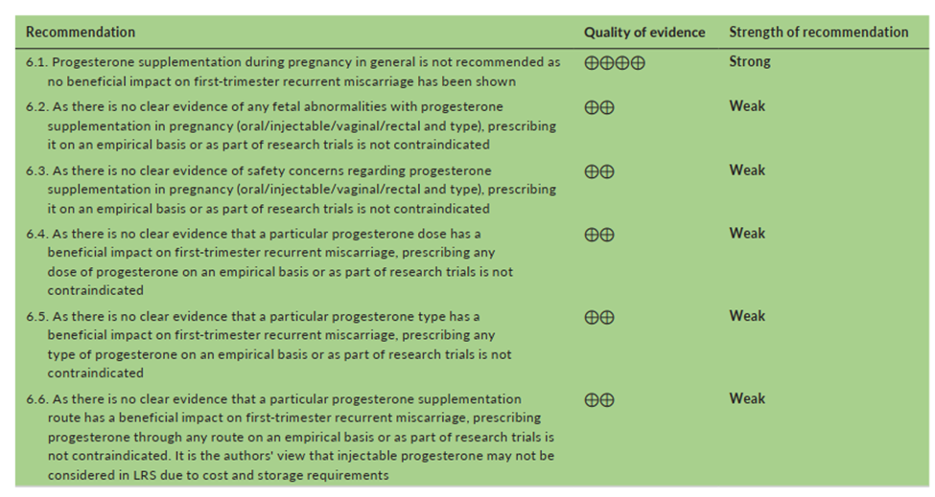
FIGO- 2023
General recommendations
Notes:
The counterargument should be the most common argument against the topic. The goal for this slide is to address the counterargument in such a way as to actually strengthen the original topic. Be sure to address each piece of evidence against the topic. As you address each piece of evidence elaborate on the text found on the slide. Remember to transition to the final slide, the action step.

Slide 25
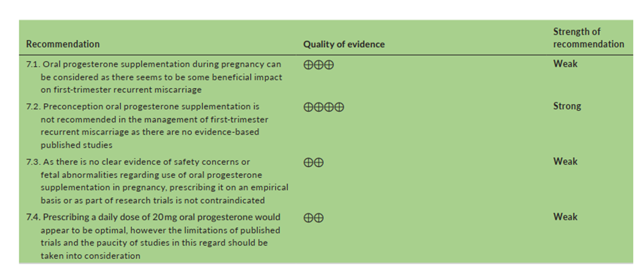
Recommendations on Oral Progesterone
Notes:
The counterargument should be the most common argument against the topic. The goal for this slide is to address the counterargument in such a way as to actually strengthen the original topic. Be sure to address each piece of evidence against the topic. As you address each piece of evidence elaborate on the text found on the slide. Remember to transition to the final slide, the action step.

Slide 26
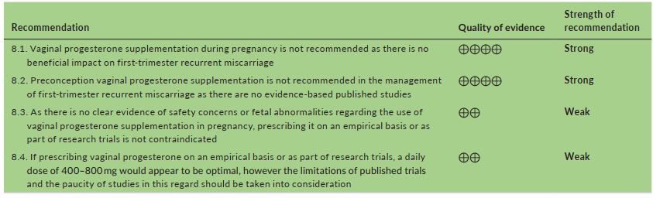
Recommendations on vaginal Progesterone
Notes:
The counterargument should be the most common argument against the topic. The goal for this slide is to address the counterargument in such a way as to actually strengthen the original topic. Be sure to address each piece of evidence against the topic. As you address each piece of evidence elaborate on the text found on the slide. Remember to transition to the final slide, the action step.

Slide 27
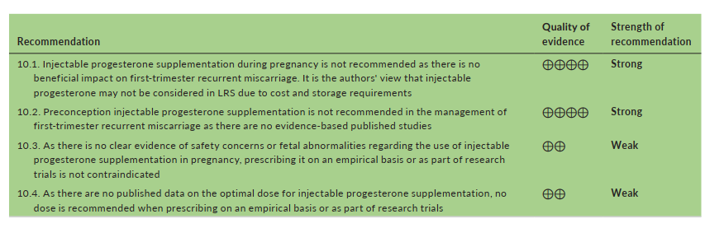
Recommendations on Intramascular Progesterone
Notes:
The counterargument should be the most common argument against the topic. The goal for this slide is to address the counterargument in such a way as to actually strengthen the original topic. Be sure to address each piece of evidence against the topic. As you address each piece of evidence elaborate on the text found on the slide. Remember to transition to the final slide, the action step.

Slide 28
Eshre-2022
Vaginal progesterone may improve live birth rate in women with 3 or more pregnancy losses and vaginal blood loss in a subsequent pregnancy (Conditional)
There is some evidence that oral dydrogesterone initiated when fetal heart action can be confirmed may be effective, but more trials are needed.
Ref - Recurrent Pregnancy Loss – Guideline of the European Society of Human Reproduction and Embryology. Belgium: ESHRE, 2022.

Slide 29
Therapeutic Gaps in the Available Progestins
Progesterone can be administered via oral, intramuscular, intravaginal, subcutaneous, or rectal routes. To date, progesterone has most commonly been administered via the intramuscular and intravaginal routes.
While oral administration is convenient for patients, oral micronized progesterone has relatively low bioavailability and undergoes extensive ¬first-pass metabolism, limiting its use for luteal phase support in IVF.
Micronized vaginal progesterone (MVP) is associated with its own vaginal administration-related side effects, including irritation and discharge and some women may not be comfortable using MVP due to cultural reasons. Recently, MVP has been shown in a pilot IVF study to affect the local microbiome. It has been postulated, following endometrial alterations in the uterine microbiome in response to inflammation, that a progesterone-resistant endometrium can develop.
Griesinger G, Blockeel C, Kahler E, Pexman-Fieth C, Olofsson JI, Driessen S, et al. (2020) Dydrogesterone as an oral alternative to vaginal progesterone for IVF luteal phase support: A systematic review and individual participant data meta-analysis. PLoS ONE 15(11): e0241044

Slide 30
Therapeutic Gaps in the Available Progestins
The conventional natural progesterone is bound by various limitations, like-
Low oral bioavailability
High dose requirement due to low potency
Metabolic instability

Slide 31
Therefore, a progestogen with more bioavailability, efficacy, safety and tolerability with convenient route of administration is desired to ensure the optimum management of threatened or recurrent miscarriage and luteal phase defect.
That’s where
the story of Dydrogesterone begins!

Slide 32
Clinical evidences

Slide 33
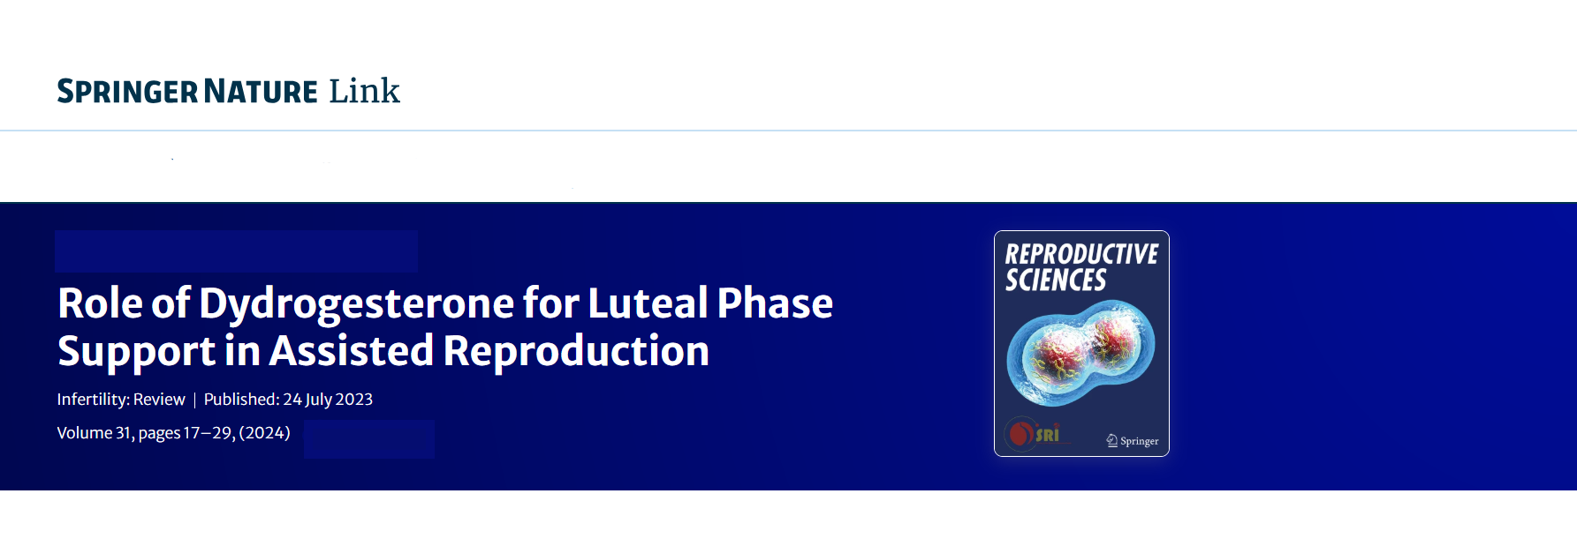




Abstract
Clinical outcomes of in vitro fertilization (IVF) have significantly improved over the years with the advent of the frozen–thawed embryo transfer (FET) technique. Ovarian hyperstimulation during IVF cycles causes luteal phase deficiency, a condition of insufficient progesterone. Intramuscular or vaginal progesterone and dydrogesterone are commonly used for luteal phase support in FET. Oral dydrogesterone has a higher bioavailability than progesterone and has high specificity for progesterone receptors. Though micronized vaginal progesterone has been the preferred option, recent data suggest that oral dydrogesterone might be an alternative therapeutic option for luteal phase support to improve clinical outcomes of IVF cycles. Dydrogesterone has a good safety profile and is well tolerated. Its efficacy has been evaluated in several clinical studies and demonstrated to be non-inferior to micronized vaginal progesterone in large-scale clinical trials. Oral dydrogesterone may potentially become a preferred drug for luteal phase support in millions of women undergoing IVF.

Slide 34

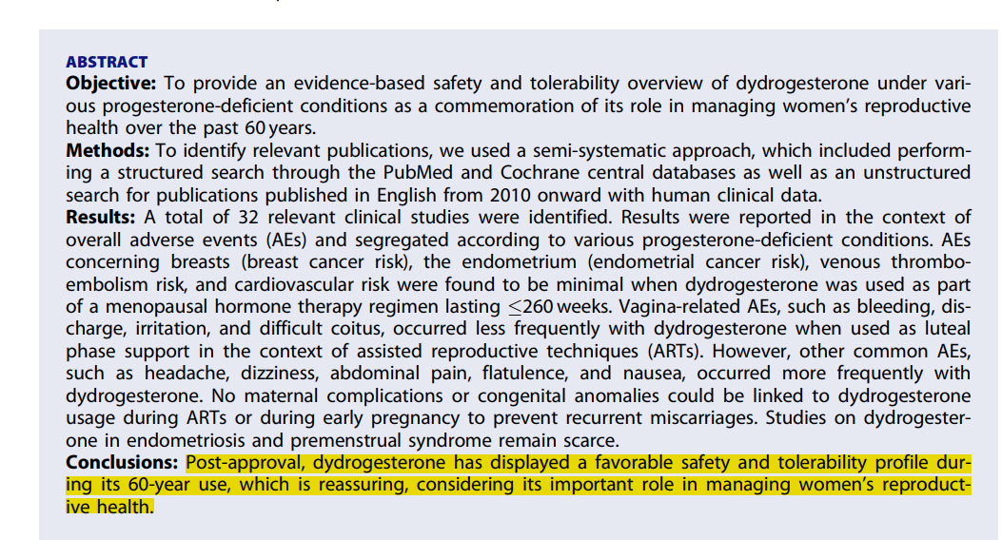

Slide 35
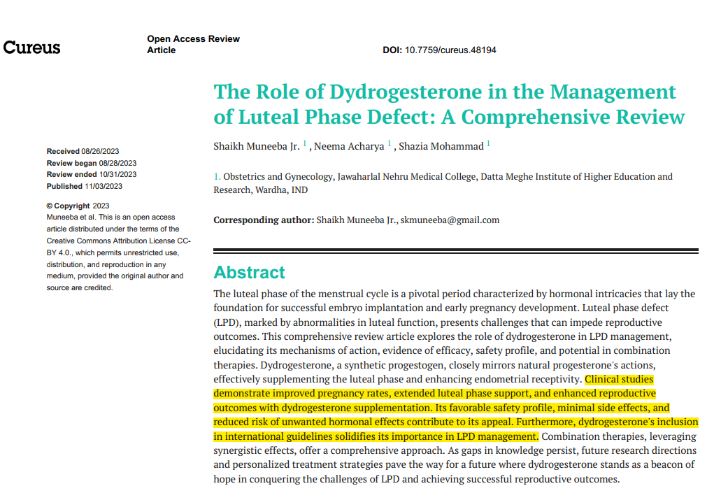

Slide 36
Conclusion
The management of RPL is complex, necessitating a comprehensive approach.
A thorough evaluation to identify underlying factors, including anatomical, endocrinological, and immunological causes, is essential. Additionally, addressing lifestyle factors and providing psychological support are integral components of care.
While evidence-based treatments remain limited, it's crucial to offer patients a plan for future pregnancies, particularly when modifiable causes are identified.
Dydrogesterone has shown promise in reducing the incidence of pregnancy loss in threatened abortion during the first trimester, with studies demonstrating a 95% success rate and positive effects on uterine and fetal circulation.
Further research and tailored treatment strategies are essential to improve outcomes for women experiencing RPL.

Slide 37
Thank you

